Slide 1
Reward-Emotion Interaction
Group Name: “The Emo Gamblers”
Pod: Asida
Pod TA: Alish Dipani | Project TA: Emeka Ogbuju Project Mentor: Dr. Alexandre Rivkind
Group Members:
Muskan Mittal, Sanghyun Park, Sara Rostami, Srijita Karmakar

Slide 2
Introduction
Gambling (really, Reward/Punishment) Task
Dataset
HCP 2021 (fMRI)
Emotion Task
How does the neural response to emotion cues correlate with the neural responses to reward and punishment?
Question
Brain areas more active during emotion cognition would also show higher activity on receiving reward and/or punishment feedback
Hypothesis
Sander and Nummenmaa 2021
Barch et al 2013
Yankouskaya et al 2022, Park et al 2018
1
Notes:
https://doi.org/10.1016/j.cobeha.2021.03.016
https://doi.org/10.1016/j.neuroimage.2013.05.033
https://doi.org/10.3389/fnsys.2022.833625 It remains unclear whether reward and emotion-related processing share the same neural connection topology and how intrinsic brain functional connectivity organization changes to support emotion- and reward-related prioritized effects in decision-making
https://doi.org/10.3758/s13415-018-0587-3: better task design, positive, negative, neutral for both emotion and feedback stimuli within the same task: Across tasks, we found shared valence effects in the ventromedial prefrontal cortex and left inferior frontal gyrus (part of dorsolateral prefrontal cortex), with increased activity for positive and negative stimuli, respectively. Despite this commonality, emotion and reward tasks featured differential behavioural patterns in that negative valence effects (performance costs) were exclusive to emotional stimuli, while positive valence effects (performance benefits) were only observed for reward-related stimuli.

Slide 3
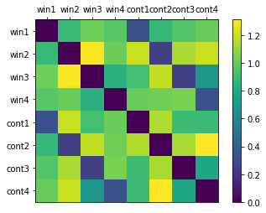
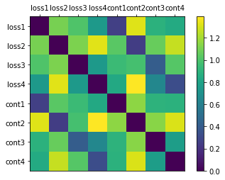
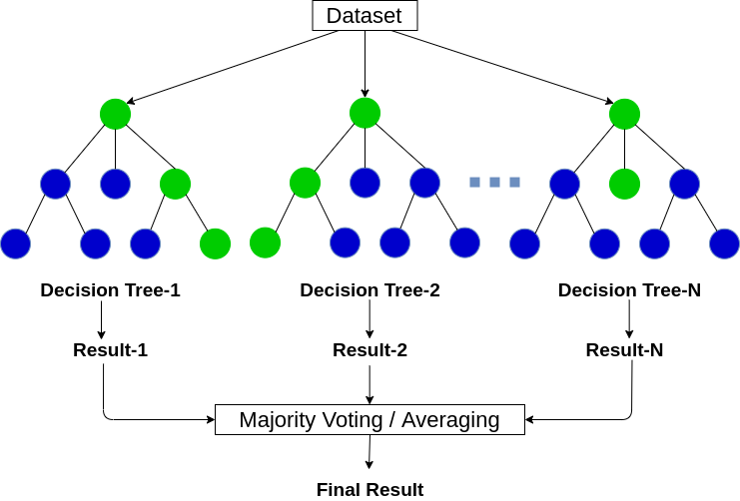
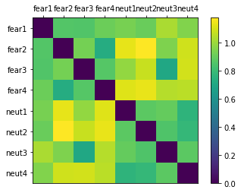


Method
Positive-feedback RDM
Negative-feedback RDM
RDM & RSA analysis (individual-level)
Decoding analysis
(group-level, Random Forest Classifier)
Comparing decoding results with RSA
2
Emotion RDM

Slide 4
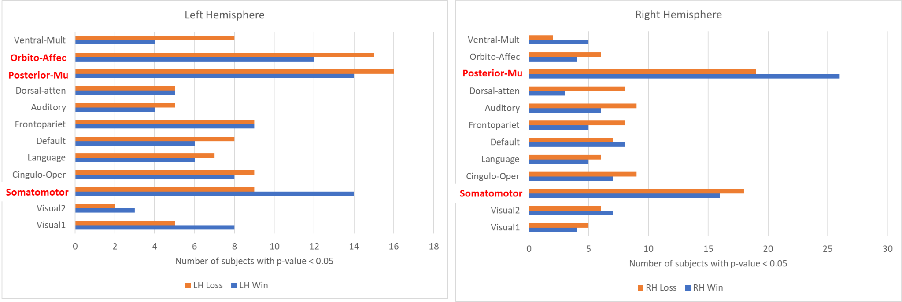
Result: Individual-Level Analysis
Representational Similarity Analysis:
No. of subjects with RSA p<0.05 across ROIs
3
Notes:
ventral multimodal
Orbito affective
posterior multimodal
Cingulo-opercular

Slide 5
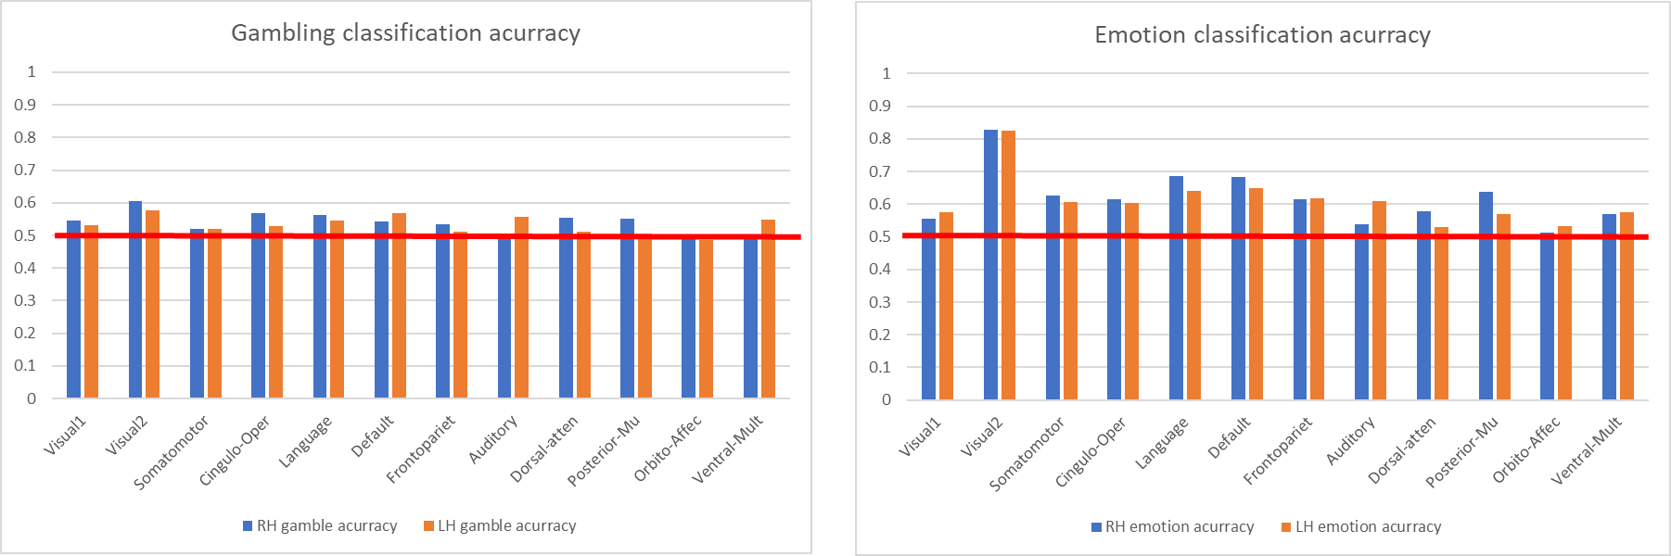
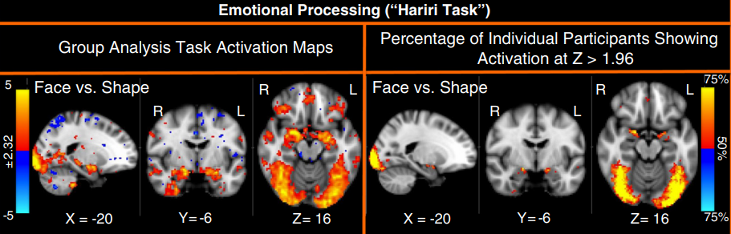
Result: Group-Level Analysis
Decoding accuracy: Train (Emotion Dataset) → Test (Emotion Dataset)

Slide 6
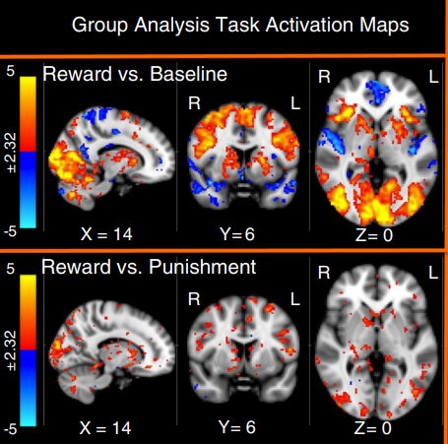
Result: Group-Level Analysis
Decoding accuracy: Train (Gambling Dataset) → Test (Gambling Dataset)
4
from Barch et al 2013

Slide 7
Conclusion
RSA evinces correlation between emotion response and positive/negative feedback response in some ROIs in both left and right hemispheres
Decoding accuracy of RF classifiers: lower for gambling responses and did not correlate with RSA results
Individual-level correlations observed, but not group-level
Limitations:
The gambling task did not offer enough neutral condition data to build win/loss RDMs appropriately
The choice of decoding classifier may not have been well suited for the given data
Only cortical regions in the dataset
Future Directions:
Future research would benefit from task paradigms that combine reward and emotion measures
5
Notes:
https://doi.org/10.3389/fnsys.2022.833625 The results revealed that interaction between the Default Mode Network, Frontoparietal, Dorsal Attention, and Salience networks engaged distinct topological structures to support the effects of reward, positive and negative emotion processing. (April, 2022: )

Slide 8
Special Thanks to NMA!

Slide 9
Following slides not part of main presentation

Slide 10
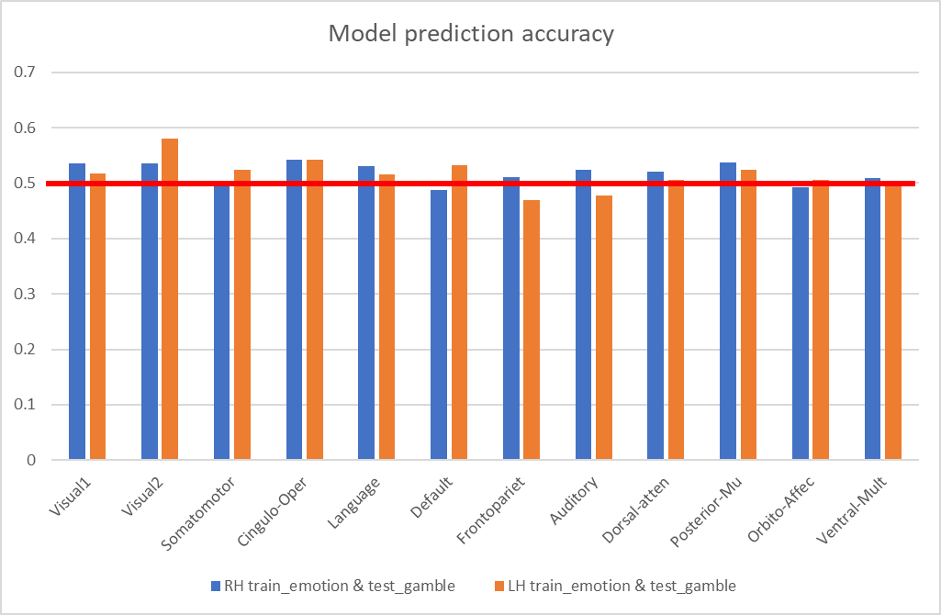
Classification model accuracy: Train (Emotion Dataset) → Test (Gambling Dataset)

